Slide 1
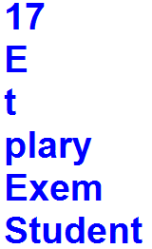
1. Create a string variable and assign with "Exemplary Student".
Get the length of a string.
Get the first character of a string.
Get the last character of a string.
Get the characters from position 4 to position 9 (not included).
Get the characters from the start to position 4 (not included).
Get the characters from position 10, and all the way to the end.
Output

Slide 2
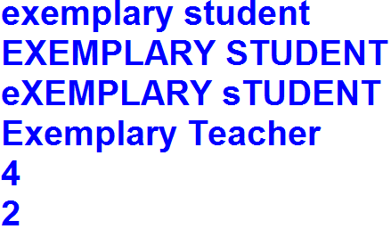
2. Create string variable and assign with "Exemplary Student".
Convert a string into lower case.
Convert a string into upper case.
Convert a string from lower case to upper case and vice versa.
Replace the word "Student" to "Teacher“ in string.
Find the position of the letter p in string.
Count the letter e in string.
Output

Slide 3
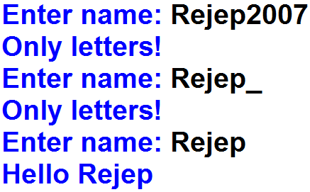
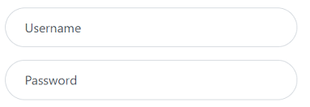
3. Get a name from the user until write the correct name. The name must consist of only letters.
Output

Slide 4
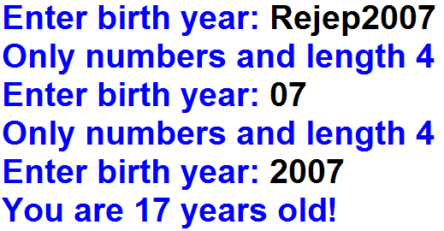
4. Get a birth year from the user until write the correct birth year and calculate user’s age. The birth year must consist of only numbers and its length 4.
Output

